Slide 1

PROJECT COST MANAGEMENT

Slide 2
Project Cost Management
This knowledge area includes the processes involved in estimating, budgeting, and controlling costs so that the project can be completed within the approved budget.
Project Cost Management is primarily concerned with the cost of the resources needed to complete project activities.

Slide 3
Project Cost Management
These processes are preceded by a planning effort to prepare a cost management plan which shall dictate:
  Level of accuracy of the estimate - An estimate is at best an approximation / forecast of the costs to be incurred to produce a deliverable or a product.
  Unit of Measure (UOM) - It is the unit of measurement to identify the scope of work. Examples include feet, meter, ft2, m3, liters, tons, man hours (hours), days or lump sum.
  Currency Unit – (Dollar (USD), Rupees (RS), Dirham's (AED) etc.

Slide 4
Project Cost Management
  The format and frequency of various cost reports to be used.
  Rules for measuring cost performance - This includes use of Earned Value techniques (described later).
  Cost components – division of cost into the direct and indirect cost
  Control Thresholds - Defines the limits of variation about the baseline beyond which action would be required.

Slide 5
Project Cost Management Processes
Estimate Costs
Determine Budget
Control Costs

Slide 6
Estimate Costs
It is the process of developing an approximation of the monetary resources required to complete project activities.
Cost estimates are generally expressed in units of some currency i.e. dollars, euro, yen, etc.
In other instances units of measure such as labor hours are used.

Slide 7
Estimate Costs
Costs are estimated for all resources that will be charged to the project which include labor, materials, equipment, services, and facilities.
It also includes special categories such as inflation allowance or contingency costs.

Slide 8
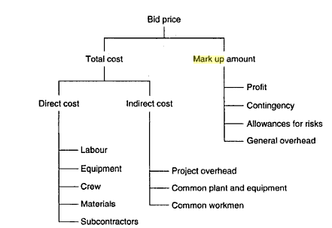
Estimate Costs
Classification of Costs

Slide 9
Estimate Costs
Direct Cost – are related to the actual performance of the activity.
  This includes material, labor, plant & equipment, subcontracting costs.
Indirect Cost – are not physically attributable to a single activity.
  This includes project overheads such as salaries of project site engineers, administrators, supervisors, project manager etc., insurance, financing, temporary site facilities, site utilities etc. Common plant and equipment such as diesel generators, water pumps etc.
Mark-up is an addition over the base estimate to cover for profit and head office overhead costs. Contingencies related to the project may also be treated as a part of Mark-up. Mark-up can also be treated as an indirect cost since it is not directly attributable to work activities of a project.

Slide 10
Estimate Cost: Techniques
Analogous Estimating
  Uses the estimates of actual cost per unit parameter such as covered area for buildings (cost/ft2) to estimate the cost of current/future projects. This also requires adjustments for known differences.
Parametric Estimating
  Parametric estimating uses a statistical relationship between historical data and other variables (e.g., square footage in construction) to calculate an estimate for activity parameters, such as cost, budget, and duration.

Slide 11
Estimate Cost: Techniques
  Example (An exponential function derived for estimating building cost at Georgia Institute of Technology in 1988):
  C = 0.0861*H1.184*S-0.529*D1.459*L0.343*Ag0.201
  Where:
  H = Height of Building
  S = Number of Stories
  D = Duration of Project
  L = Liquidated Damages
  Ag = Gross Floor Area

Slide 12

Estimate Cost: Techniques
Bottom-Up Estimating
  Bottom-up estimating is a method of estimating a component of work. The cost of individual work packages or activities is estimated with the greatest level of specified detail. The detailed cost is then summarized or “rolled up” to higher levels for subsequent reporting and tracking purposes.
  Example: Working out cost of formwork, reinforcement, cement, sand, aggregate, water, labor hours, equipment hours for a concrete slab work package.
Three-Point Estimates
  The idea is similar to PERT by using three point estimates of cost instead of one to accommodate risk and uncertainty.
  Most likely (cM). The cost of the activity, based on realistic effort assessment for the required work and any predicted expenses.
  Optimistic (cO). The activity cost based on analysis of the best-case scenario for the activity.
  Pessimistic (cP). The activity cost based on analysis of the worst-case scenario for the activity.

Slide 13
Estimate Cost: Techniques
Project Management Estimating software
  Various software packages are available on the market that contain cost databases and tools to simplify the cost estimation.
Vendor Bid Analysis
  Cost estimating methods may include analysis of what the project should cost, based on the responsive bids from qualified vendors.

Slide 14


INPUTS OF COST ESTIMATION

Slide 15
Estimate Cost: Inputs
Scope Baseline
  Scope statement - provides the product description, acceptance criteria, key deliverables, project boundaries, assumptions, and constraints about the project.
  WBS - provides the relationships among all the components of the project and the project deliverables.
  WBS Dictionary - provide an identification of the deliverables and a description of the work in each WBS component required to produce each deliverable.

Slide 16
Estimate Cost: Inputs
Project Schedule – the type and the quantity of resources and the amount of time for which these are applied to the project activities will affect the cost estimate. Time is important for cost estimating as it will affect the cost where resources are applied per unit time (equipment rent, labor wages etc..) and the cost of financing the project (interest rates). Time will also impact cost in terms of risk of inflation in resource rates.
Human Resource Plan – Staffing requirements, personnel salaries, compensation and benefits etc.
Risk Register – Cost to address or control identified risks.

Slide 17

OUTCOMES OF COST ESTIMATION

Slide 18
Estimate Costs: Output
The outputs include:
  Activity Cost Estimates
    They are quantitative assessments of the probable costs required to complete project work. Cost estimates are presented in summary or detailed form
  Basis of Estimates
    It includes the additional detail supporting the cost estimate.
      Documentation of the basis of the estimate (i.e. how it was developed)
      Indication of the range of possible estimates (e.g., $10,000 (+/- 10%) to indicate that the item is expected to cost between a range of values), and
      Indication of the confidence level of the estimate

Slide 19
Determine Budget
It is the process of aggregating the estimated costs of individual activities or work packages to establish a cost baseline.
Project budgets constitute the funds authorized to execute the project. Project cost performance will be measured against the authorized budget.
This is the amount of money that an organization needs to set aside or have available for the project.

Slide 20
Determine Budget
A reserve analysis needs to be performed for each activity to determine the suitable amount of contingency allowance (Cost to cover foreseen and unforeseen risks).
This (Contingency reserve) along with the activity cost is rolled up to produce work package costs which are than subsequently rolled up the WBS levels to arrive at the project cost. This will result in a cost baseline of the project. Contingency reserve is for the known-unknowns.
At this point another reserve called the management reserve may be added to the cost baseline to cover for any unforeseen or other costs to develop the cost budget for the project. The management reserve is not for the Project manager to use. Management reserve is for the unknown-unknowns.

Slide 21
Determine Budget
The next step is to time-phase the cost baseline and to develop a project cash flow.
This is also a part of the cost budgeting process.

Slide 22
Determine Budget: Input
Activity Cost Estimates (for aggregating costs to higher level)
Basis of Estimates (Any assumptions made while preparing the cost estimate – such as indirect costs)
Scope Baseline
Project Schedule (To time phase the budget)

Slide 23
Determine Budget: Output
The outputs include:
  Cost Performance Baseline
    It is an authorized time-phased budget at completion (BAC) used to measure, monitor, and control overall cost performance on the project. It is developed as a summation of the approved budgets by time period and is typically displayed in the form of an S-curve.
  Project Funding Requirements
    Total funding requirements and periodic funding requirements (e.g., quarterly, annually) are derived from the cost baseline. The cost baseline will include project expenditures plus anticipated liabilities.

Slide 24
Determine Budget: Output
S-Curve is used to show growth of a variable in terms of another variable. In construction industry these are used to graphically represent the progress of the project over time. This progress may be measured in units of budgeted cost.
A cumulative curve plotting work progress against time. Work progress may be expressed in terms of units of work, budget, man-hours, percent complete, or other. The curve loosely resembles the letter S because work typically starts at a light scale then intensifies towards the middle of the project, and finally lightens up again towards the end of the project. The curve is sometimes called ‘‘Lazy S-curve’’.

Slide 25
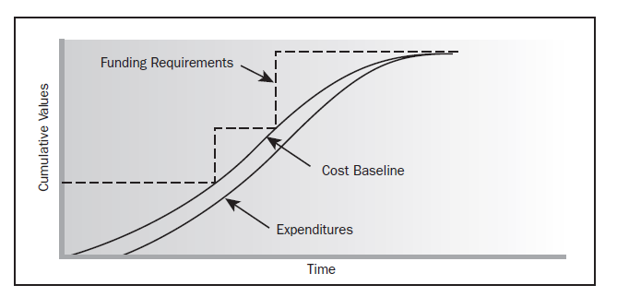
Determine Budget: Output
S-Curve

Slide 26
Determine Budget
Project Document Updates
  It may include:
    Risk register
    Cost estimates
    Project schedule

Slide 27
Control Costs
It is the process of monitoring the status of the project to update the project budget and managing changes to the cost baseline.
Thus effort of cost control involves analyzing the relationship between the consumption of project funds to the physical work being accomplished for such expenditures. The key to effective cost control is the management of the approved cost performance baseline and the changes to that baseline.

Slide 28
Control Costs
Project cost control includes:
  Influencing the factors that create changes to the authorized cost baseline
  Ensuring that all change requests are acted on in a timely manner
  Managing the actual changes when and as they occur
  Ensuring that cost expenditures do not exceed the authorized funding, by period and in total for the project
  Monitoring cost performance to isolate and understand variances from the approved cost baseline
  Monitoring work performance against funds expended
  Preventing unapproved changes from being included in the reported cost or resource usage,
  Informing appropriate stakeholders of all approved changes and associated cost, and
  Acting to bring expected cost overruns within acceptable limits.

Slide 29
Cost Control: Inputs
Cost Performance baseline
  The cost performance baseline is compared with actual results to determine if a change, corrective action or preventive action is necessary.
Cost management plan
  The cost management plan describes how the project costs will be managed and controlled.
Work Performance Information
  Work performance information includes information about project progress, such as which deliverables have started, their progress and which deliverables have finished. Information also includes costs that have been authorized and incurred, and estimates for completing project work.

Slide 30
Cost Control: Tools & Techniques
Data Date
  The data date is the last date you recorded progress in the form of actual dates, percent of work completed, revised remaining duration, or actual quantities or costs.
Earned Value Management (EVM)
  Started in 1960’s as an integrated method of cost and schedule control. Introduced by US Air Force.
  Previously known as cost/schedule control systems criteria (C/SCSC).
  Earned value management (EVM) in its various forms is a commonly used method of performance measurement. It integrates project scope, cost, and schedule measures to help the project management team assess and measure project performance and progress. It is a project management technique that requires the formation of an integrated baseline against which performance can be measured for the duration of the project.

Slide 31
Cost Control: Tools & Techniques
The concept of earned value (EV) is simple; at any given point, take the following five steps:
1. Determine how much work you have done and how much you should have done according to the plan.
2. Determine how much money you have earned and how much money you have spent.
3. Calculate the time (schedule) and money (budget) deviations (variances) so far.
4. Analyze the causes for the major deviations and determine possible remedies.
5. Extrapolate these deviations to the end of the entire project. (Forecasting)

Slide 32
Cost Control: Tools & Techniques
Important Terms
  BCWS (Budgeted cost of work Scheduled) or PV (Planned Value)
    Planned value (PV) is the authorized budget assigned to the work to be accomplished for an activity or work breakdown structure component. It includes the detailed authorized work, plus the budget for such authorized work, allocated by phase over the life of the project. The total of the PV is sometimes referred to as the performance measurement baseline (PMB). The total planned value for the project is also known as Budget At Completion (BAC).
  BCWP (Budgeted Cost of Work Performed) or EV (Earned Value)
    Earned value (EV) is the value of work perform(ed) expressed in terms of the approved budget assigned to that work for an activity or work breakdown structure component. It is the authorized work that has been completed, plus the authorized budget for such completed work.
    The EV being measured must be related to the PV baseline (PMB), and the EV measured cannot be greater than the authorized PV budget for a component. The term EV is often used to describe the percentage completion of a project.
  ACWP (Actual Cost of Work Performed) or AC (Actual Cost)
    Actual cost (AC) is the total cost actually incurred and recorded in accomplishing work performed for an activity or work breakdown structure component. It is the total cost incurred in accomplishing the work that the EV measured. The AC will have no upper limit; whatever is spent to achieve the EV will be measured.

Slide 33
Cost Control: Tools & Techniques
Variance from the approved baseline will be monitored using measures of variance.
Schedule Variance
  Schedule variance (SV) is a measure of schedule performance on a project. It is equal to the earned value (EV) minus the planned value (PV). The EVM schedule variance is a useful metric in that it can indicate a project falling behind its baseline schedule. The EVM schedule variance will ultimately equal zero when the project is completed because all of the planned values will have been earned.
  Equation: SV = EV – PV.
Cost Variance
  Cost variance (CV) is a measure of cost performance on a project. It is equal to the earned value (EV) minus the actual costs (AC). The cost variance at the end of the project will be the difference between the budget at completion (BAC) and the actual amount spent. The EVM CV is particularly critical because it indicates the relationship of physical performance to the costs spent. Any negative EVM CV is often non-recoverable to the project.
  Equation: CV= EV – AC.

Slide 34
Cost Control: Tools & Techniques
The SV and CV values can be converted to efficiency indicators to reflect the cost and schedule performance of any project for comparison against all other projects or within a portfolio of projects. The variances and indices are useful for determining project status and providing a basis for estimating project cost and schedule outcome.
Schedule Performance Index (SPI)
  The schedule performance index (SPI) is a measure of progress achieved compared to progress planned on a project. The SPI is equal to the ratio of the EV to the PV.
  Equation: SPI = EV/PV.
Cost Performance Index (CPI)
  The cost performance index (CPI) is a measure of the value of work completed compared to the actual cost or progress made on the project. It is considered the most critical EVM metric and measures the cost efficiency for the work completed. A CPI value less than 1.0 indicates a cost overrun for work completed. A CPI value greater than 1.0 indicates a cost under run of performance to date.
  The CPI is equal to the ratio of the EV to the AC.
  Equation: CPI = EV/AC.

Slide 35
Cost Control: Tools & Techniques
Outputs:
  Work Performance Measurements
    The calculated CV, SV, CPI, and SPI values for WBS components, in particular the work packages and control accounts, are documented and communicated to stakeholders.
  Change Requests
    Analysis of project performance can result in a change request to the cost performance baseline or other components of the project management plan. Change requests can include preventive or corrective actions.
  Project Management Plan Updates
    Elements of the project management plan that may be updated include, but are not limited to:
      Cost performance baseline. Changes to the cost performance baseline are incorporated in response to approved changes in scope, activity resources, or cost estimates. In some cases, cost variances can be so severe that a revised cost baseline is needed to provide a realistic basis for performance measurement.
      Cost management plan.

Slide 36
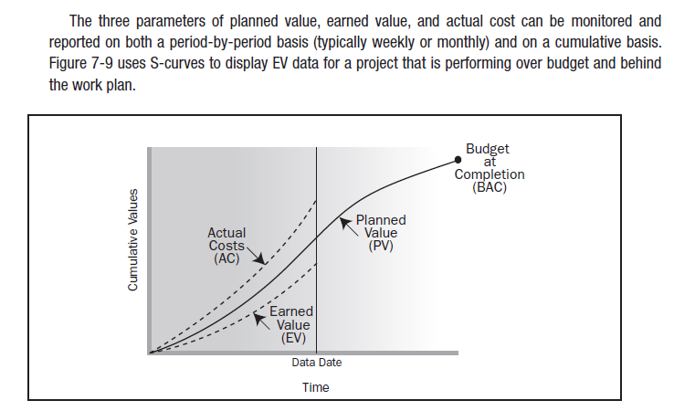
Cost Control: Tools & Techniques

